Slide 1
PROGRAM ASSIGNMENT
Extend a Real
Product
Jira Cloud: a dependency and capacity dashboard for SAFe Agile Release Trains, with two teams now and room for six.
Format: Slide deck
Individual: Ramyesh
Tech Cohort 19

Slide 2
01 PICK A REAL PRODUCT
Why Jira Cloud
Payments
Used every day
1
We plan sprints and features in it
Platform
Checkout
2
Big enough to extend
Jira Cloud
Boards, plans and a Forge app platform
Mobile
Catalogue
3
A real gap
Search
No view of dependencies and load together
One ART, six teams, two tools (Mobile runs on Azure DevOps)

Slide 3
02 THE EXISTING TECH STACK
What Jira runs on, and where our features sit
Screens
React + Atlaskit
Forge (our features)
Services
Java
Kubernetes
Atlassian Micros
Data
Amazon RDS
DynamoDB
OpenSearch
Speed and events
Memcached
Kinesis
SNS
Cloud and security
AWS
KMS encryption
SSO and JWT
Sources: Atlassian Trust and cloud architecture pages, Atlassian engineering blog, Forge documentation.

Slide 4
03 ADD 1 TO 2 NEW FEATURES
Two features, each one useful on its own
1 ART Dependency Dashboard
2 Capacity and Utilisation
See who waits on whom
Spot overload before the sprint starts
85% line
Green, amber and red: each dot is one dependency
Bars are planned load per sprint, as a share of capacity

Slide 5
04.1 FUNCTIONAL REQUIREMENTS
Feature 1: ART Dependency Dashboard
ID | The system shall… | Priority
FR-1.1 | let a team raise a dependency request on another team's item, with a needed-by sprint | Must
FR-1.2 | let the receiving team accept (with a sprint) or reject (with a reason) | Must
FR-1.3 | show all dependencies for an ART and PI as a team matrix and a sprint timeline | Must
FR-1.4 | mark each dependency Green, Amber or Red using the risk rules | Must
FR-1.5 | filter by team, status, risk and sprint, and export to CSV | Should
FR-1.6 | show Azure DevOps items next to Jira issues, with an ADO badge | Should
Edge cases: a rejected request stays Red until re-planned · circular links are flagged · moved or deleted items become Orphaned · items a user cannot see show as Restricted · outside teams can be added as External.

Slide 6
04.1 FUNCTIONAL REQUIREMENTS
Feature 2: Capacity and Utilisation Planner
ID | The system shall… | Priority
FR-2.1 | let a Scrum Master set each member's allocation (0 to 100%) and days off per sprint | Must
FR-2.2 | work out team capacity per sprint from its members | Must
FR-2.3 | calculate load from planned estimates; utilisation = load ÷ capacity | Must
FR-2.4 | show a team-by-sprint heatmap: green 60 to 85%, amber 85 to 100%, red over 100% | Must
FR-2.5 | show a person view that adds up load across every team a person works in | Should
FR-2.6 | let the RTE test a move of an issue and see utilisation change before saving | Could
Edge cases: allocations over 100% across teams are blocked · zero-capacity sprints show "No capacity" · unestimated issues are counted and flagged · mixed units are never added together.

Slide 7
04.2 NON-FUNCTIONAL REQUIREMENTS
Six quality goals, each with a number
ID | Quality | Target
NFR-1 | Performance | Under 3 seconds for 12 teams, 5 sprints and 2,000 issues (95th percentile)
NFR-2 | Scalability | Up to 10 ARTs, 150 teams and 20,000 linked issues per site
NFR-3 | Availability | 99.9% monthly; if the Azure DevOps sync is down, Jira data still shows with a last-synced time
NFR-4 | Security and privacy | Every item checked against Jira permissions; data stays in the customer's region
NFR-5 | Data freshness | Jira changes within 1 minute; Azure DevOps every 15 minutes
NFR-6 | Accessibility | WCAG 2.1 AA; colours always paired with a label or icon

Slide 8
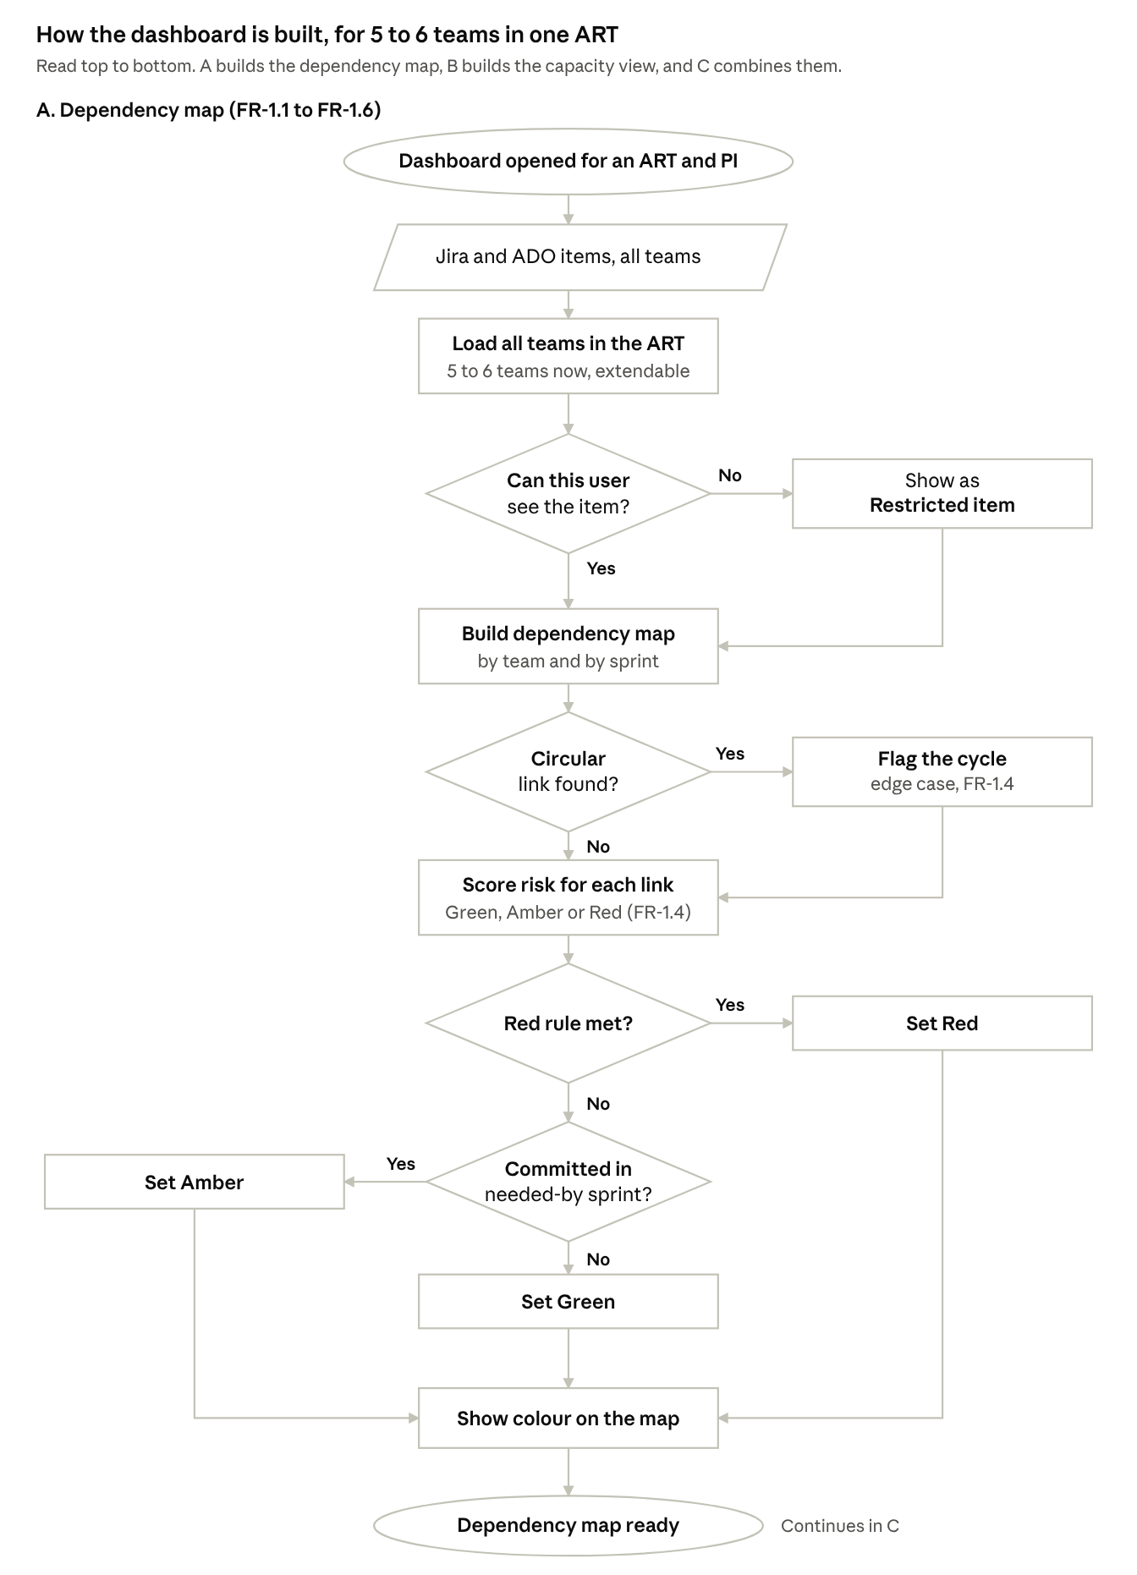
04.3 FLOW DIAGRAM
Section A: the dependency map
1
Load all teams
2
Check what each user can see
3
Map, then score risk

Slide 9
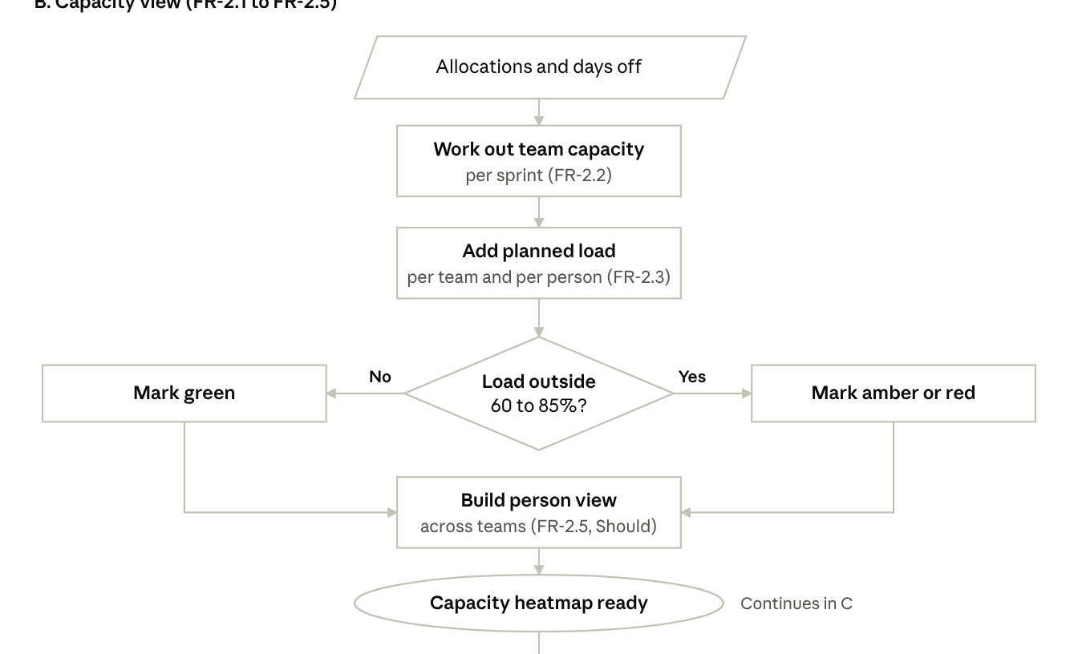
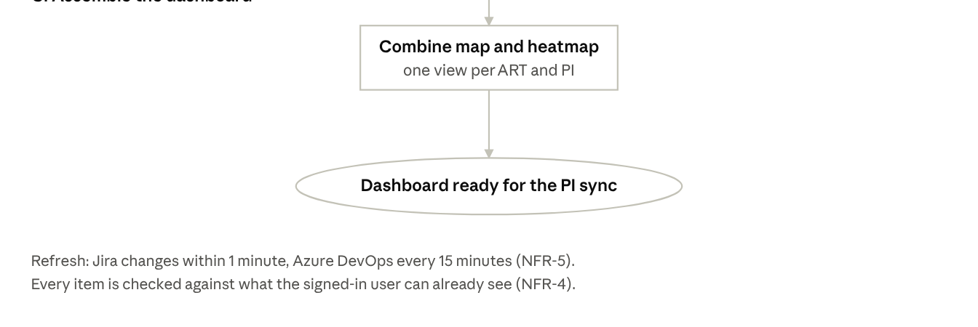
04.3 FLOW DIAGRAM
Sections B and C: capacity, then one view
B Capacity per sprint
1
Allocations and days off
Colour by load
2
Green 60 to 85%, amber or red outside
C One dashboard
3
Map and heatmap, refreshed

Slide 10
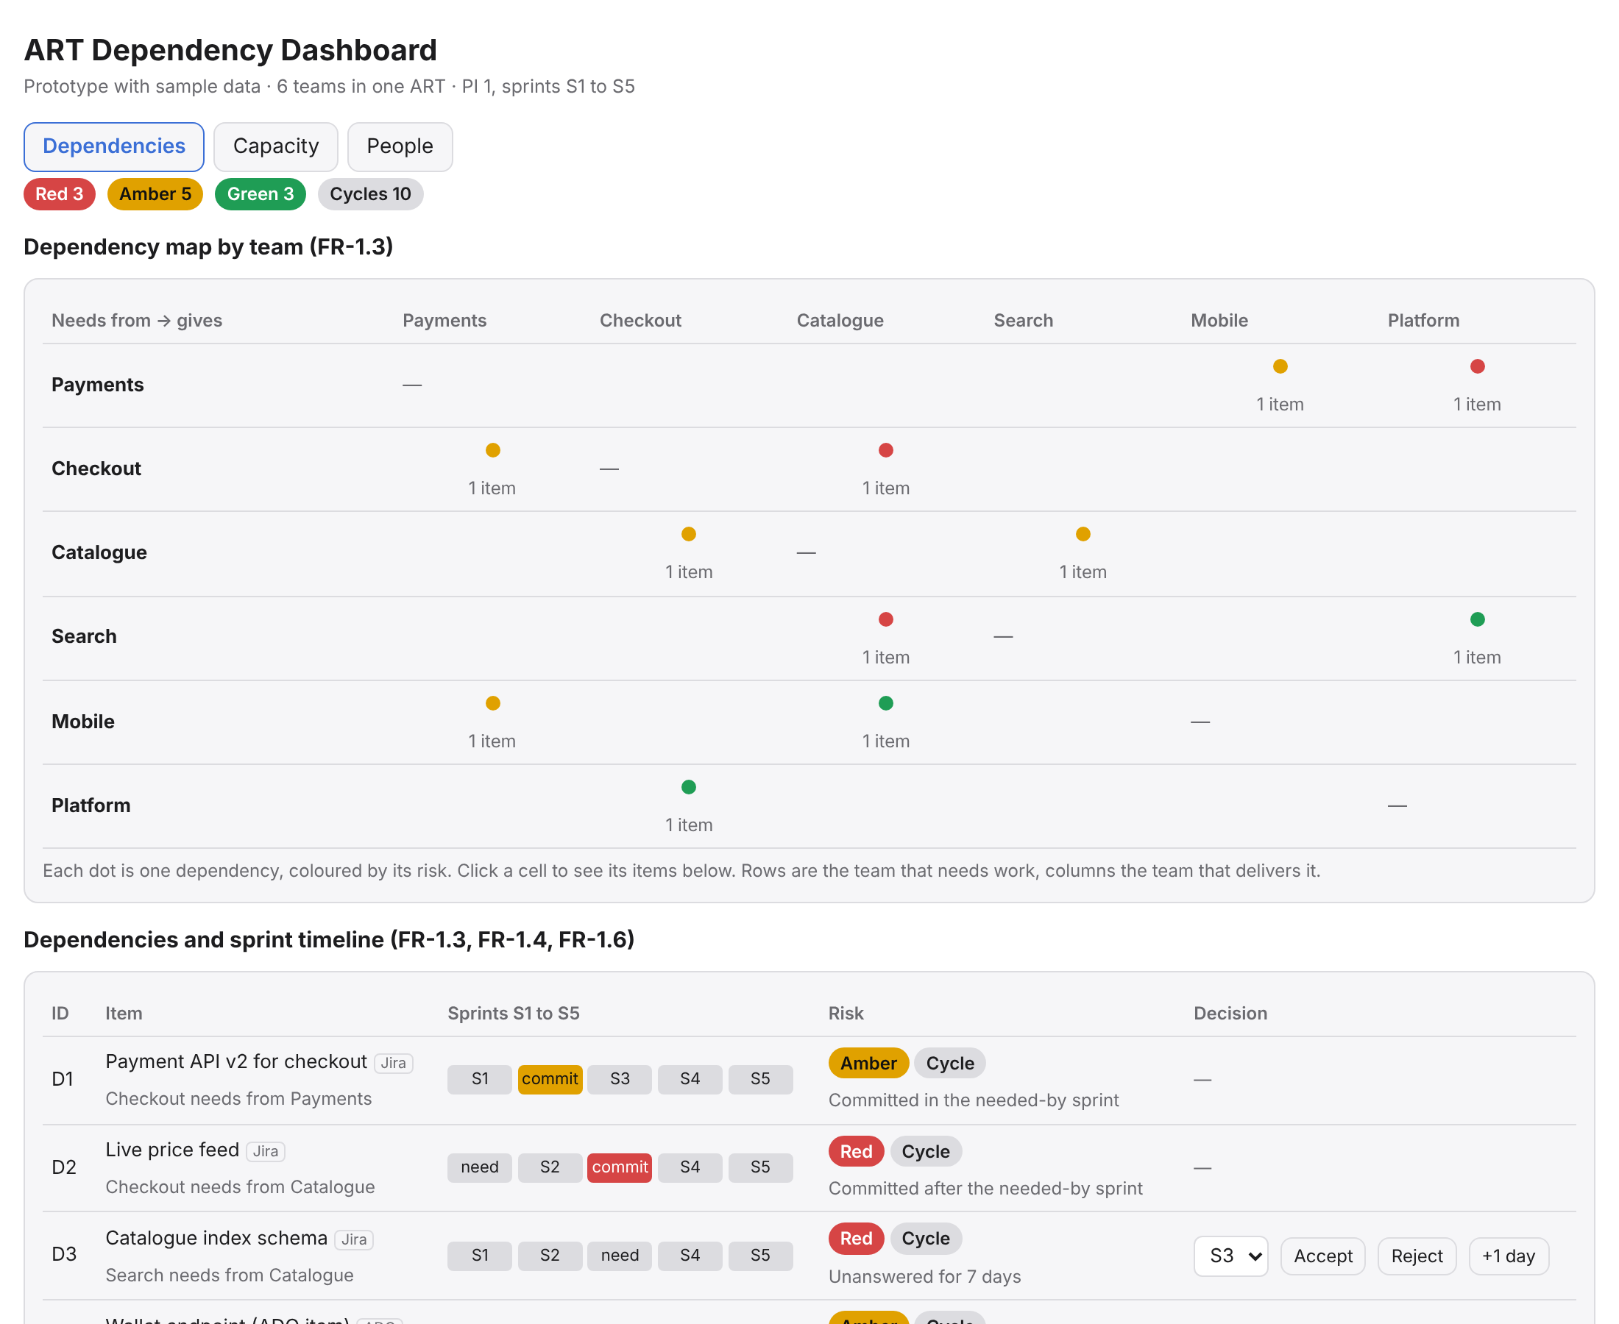
04.4 WORKING PROTOTYPE
Clickable prototype, sample data
1
Dependencies
2
Capacity
3
People
claude.ai/artifact/FtacGUD3MnfamMsFHCiaNB

Slide 11
NEXT STEPS
Thank you
1
2
3
Real Jira and ADO data
A Forge app inside Jira
All six teams

